Slide 1
COVID_19 in Nigeria
In 2020, the world was hit with a deadly pandemic and Nigeria wasn’t excluded.
This slide is just a visualization (using power Bi) story of how it spread across the African country.

Slide 2
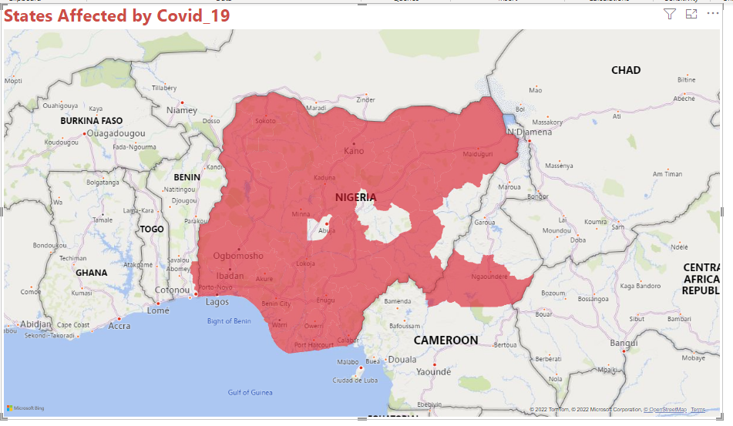
This figure shows the spread of the deadly virus across the country.
It can be seen that almost the entire regions were hit, even down to some neighbouring towns on the Cameroonian border.

Slide 3
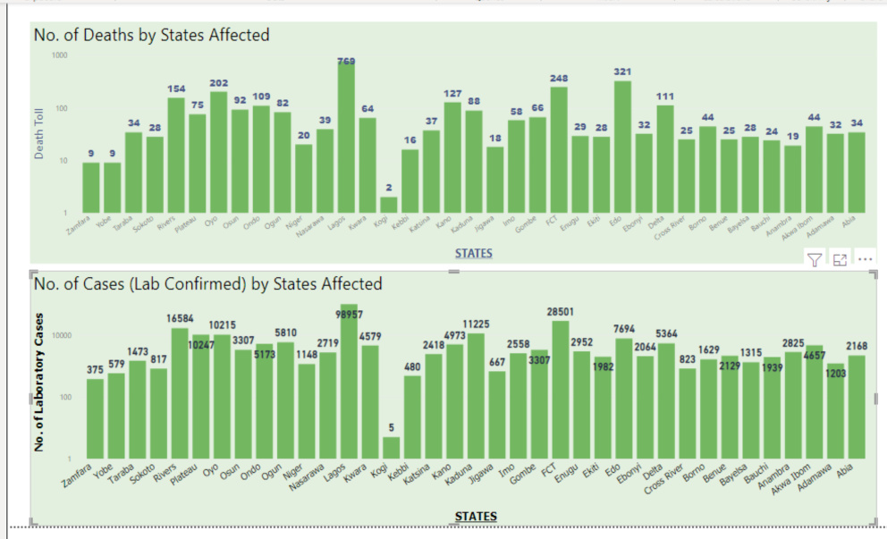
Here, we can see the number of deaths as well as the number of lab cases recorded in each state.
Lagos state recorded the number of cases as well as the highest number of deaths. It is unsurprising as it has a very large population compared to its land mass.

Slide 4
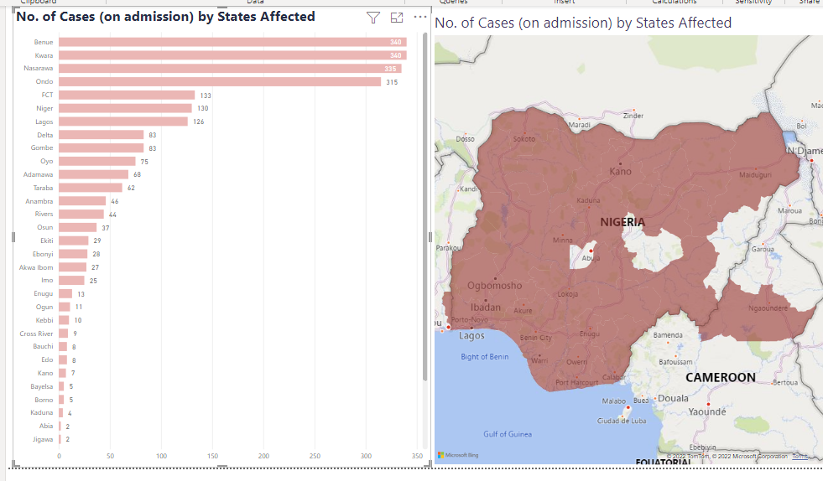
Cases of patients on admission are shown here, with Benue state leading the charge. This may be due to poor health facilities and government response.

Slide 5
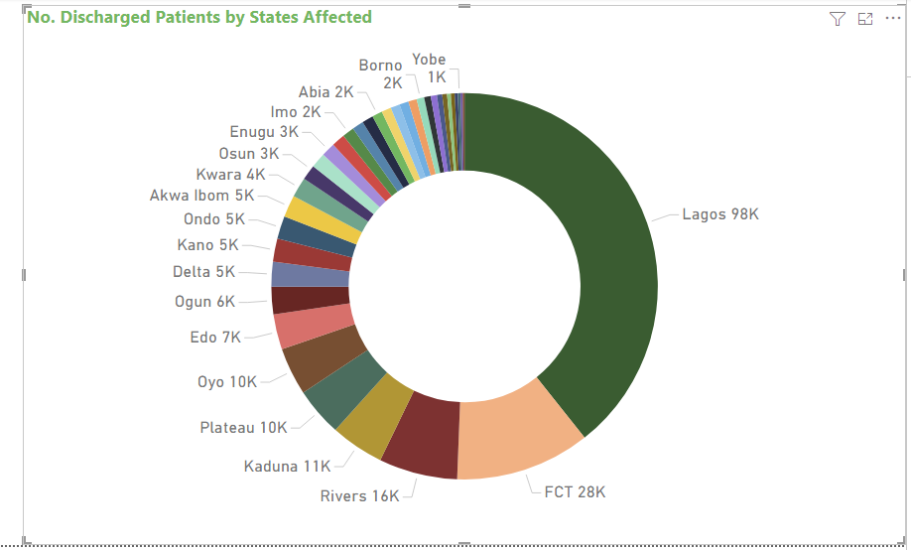
Here, we can see the number of deaths as well as the number of lab cases recorded in each state.
Lagos state recorded the number of discharged patients .

